Slide 1


Elastic Sketch: Adaptive and Fast Network-wide Measurements
Tong Yang, Jie Jiang, Peng Liu Peking University, China
Qun Huang, ICT, CAS, China
Junzhi Gong, Yang Zhou, Peking University, China
Rui Miao, Alibaba Group, China
Xiaoming Li, Peking University, China
Steve Uhlig. Queen Mary University of London, UK
Tong Yang, Peking University
yangtongemail@gmail.com
http://net.pku.edu.cn/~yangtong
Notes:
Good afternoon, everyone. My name is Tong Yang. I am from Peking University.
Today my topic is ``Elastic Sketch: Adaptive and Fast Network-wide Measurements’’.

Slide 2
Outline
PART 01
Background
PART 02
Elastic Sketch
PART 03
Optimizations
PART 04
Applications
PART 05
Implementations
PART 06
Experimental results
PART 07
Conclusion
Notes:
Here is the outline, and we first introduce the background.

Slide 3
01
PART ONE
Background
Notes:
First, we introduce the background.

Slide 4
01
Background
Measurement is important
Network measurement provides indispensable
information for network applications.
Best solution: Sketch
1) Memory efficient 2) Constant speed
3) High accuracy
Notes:
Network measurements provide important information for network operations, such as quality of service, congestion control, anomaly detection and so on.
The best solution for measurement is sketch.

Slide 5
01
Background
Most of existing solutions focus on:
A good trade-off among
1) memory usage
2) speed
3) accuracy
Recent work: UnivMon [SIGCOMM 16]
the above 3 dimensions plus 4) generality
Notes:
Existing measurement solutions mainly focus on a good trade-off among accuracy, speed and memory usage. The state-of-the-art UnivMon [2] pays attention to
an additional aspect, generality, namely using one sketch to process many tasks, and makes a good trade-off among these
four dimensions.

Slide 6
01
Background
In addition to the above 4 dimensions , our paper
5) adaptive to traffic characteristics
6) cross platform
Measurements are especially important when network is undergoing problems, such as
1) network congestion
2) scans
3) DDoS attack
In these cases, traffic characteristics vary a lot
Notes:
In additional to the above four dimensions, we pay attention to another two aspects:

Slide 7
01
Background
traffic characteristics:
1) the available Bandwidth
2) flow size distribution
3) packet arrival rate
Notes:
traffic characteristics vary drastically, significantly degrading the measurement performance. Therefore, it is desirable to achieve accurate network measurements when
traffic characteristics vary a lot.

Slide 8
01
Background---Bandwidth
Naïve Solution：
Sketch
Merging
Measurement node
Server
Merging
Measurement node
Collector
Server
Measurement node
Our Solution：
Measurement node
Compress
Notes:
The first traffic characteristic is the available bandwidth. In data centers, administrators care more about the state of the whole network than a single link or node, known as network-wide measurements.
For this, they often deploy many measurement nodes, which periodically report sketches to a collector.
However, network congestion is common, and the available bandwidth is unstable.
A naïve solution is to build many sketches with different sizes, and sent the sketch with appropriate size.
Our solution is to actively compress the sketch according to the current available bandwidth.
This is the first work to compress sketches.

Slide 9
01
Background---packet rate
The packet rate is
1) naturally variable
2) could vary drastically.
Existing sketches
1) fixed speed
2) drop packets
when packet rate becomes much higher
Our goal:
1) minimize #memory accesses → 1
2) minimize #hash computations → 1
Notes:
The packet rate is naturally variable and could vary drastically.
The processing speed of existing sketches on software platforms is fixed in terms of packet rate.

Slide 10
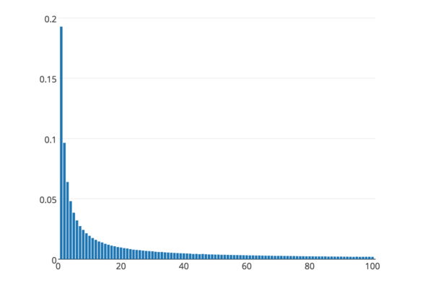
01
Background---flow size distribution
Network traffic is skewed
1) Majority: mice flows
2) Minority: elephant flows
Separation is effective
1) use large and small counters
2) use different data structures
Our goal:
1) accurate separation
2) dynamically allocate memory

Slide 11
01
Background---Cross platform
Existing solutions:
1) for CPU platforms
2) for netFPGA (OpenSketch NSDI13)
3) for P4Switch (UnivMon SIGCOMM16)
Our goal:
1) P4Switch
2) FPGA
3) GPU
4) OVS
5) CPU
6) multi-core
Notes:
Most existing solutions are designed for a specific platform.
Our goal is to achieve that the designed sketches can be implemented on six platforms.
Including …

Slide 12
01
Background- Tasks and sketches
Tasks | Sketch Algorithms
Flow size estimation | Count-Min, CM-CU, Count, ASketch
heavyhitters | Count-Min, CM-CU, Space-Saving Hashpipe, ASketch, FlowRadar, UnivMon
Heavy changes | RevSketch, FlowRadar, UnivMon
Superspreader /DDoS detection | TwoLevel
Flow size distribution | MRAC, FlowRadar
Cardinality | FM, LC, UnivMon
Entropy | FlowRadar, UnivMon
Notes:
There are many measurement tasks. Typical ones include:

Slide 13
01
Background- CM sketches
Insertion
+1
+1
+1
+1
Query
19
24
’frequency: 18
= Min{19, 24, 26, 18}
26
18
Notes:
Here we show the most classic sketch: Count-min sketch, CM sketch for short.
Suppose we have many packets, each item is a packet, and each color is a flow.
We want to know the number of packets in each flow.

Slide 14
02
PART TWO
Elastic Sketches
Notes:
Next, we present out solution – Cold filter

Slide 15
01
Rationale
Elastic Sketch
02
Basic Version
03
Adaptivity
04
Software version
05
Hardware version
06
P4 version
07
Multi-Core version
Notes:
We explain our Elastic sketch in terms of the following six aspects.

Slide 16
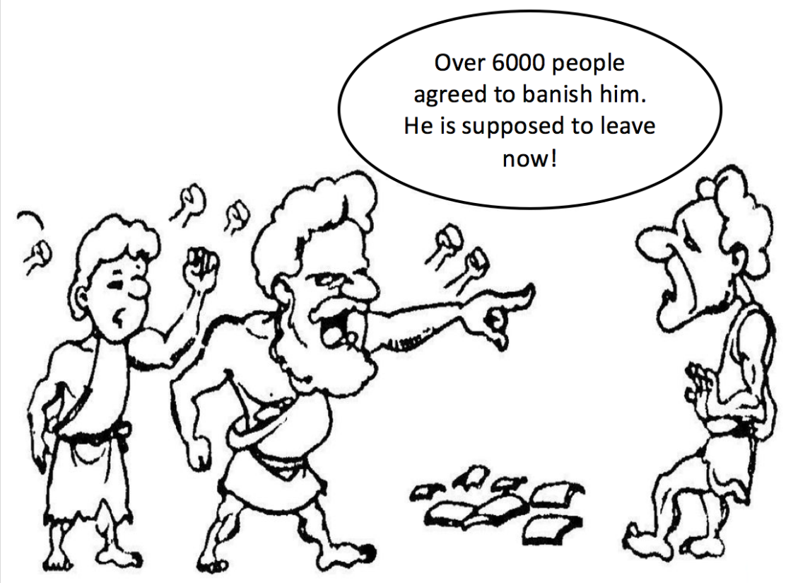
02
Elastic (Rationale)
Goal: separate elephant flows from mice flows
Ostracism: vote for elephant flows
Ostracism was a procedure in ancient Athens, any citizen could be voted to be expelled.
Problem: one bucket to elect
the largest one
One bucket
Flow ID, vote+, vote-

Slide 17
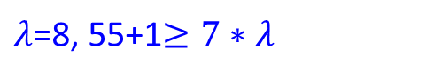
02
Elastic (Basic version)
Heavy part
Light part
<ID, Vote⁺, flag, Vote⁻>
freq
freq
h(.)
92
+1
1
f1
<f1,5,T,15>
f1,6,T,15
g1(.)
4
0
h(.)
0
6
+1
f5
f5,1,F,0
g2(.)
h(.)
7
+7
87
f8
<f3,10,F,11>
11++
f8
g1(.)
1
3
h(.)
g2(.)
f9,1,T,0
f4
2
10
+7
f9
<f4,7,F,55>
$λ$=8, 55+1$≥7∗λ$
A CM sketch
For elephant flows:
For mice flows:
For a bucket:
Notes:
Why it works?
For elephant flows, they have large positive votes, and thus with high probability will stay in the heavy part.
For mice flows, even if they are lucky to be inserted into the heavy part, but will be evicted to the light part soon.
Given a bucket in the heavy part, if the flag is false, its flow size has no error.
Otherwise, the error is incurred by mice flows in the light part, which is often small.

Slide 18
02
Elastic (Basic version)
To query a flow, heavy part → light part
1. To query it in the heavy part
check the flag of the mapped bucket
1) flag = false: report the vote⁺ with no error
2) flag = true: vote⁺ + f_light
2. To query it in the light part
report its frequency f_light as how CM sketch does
Notes:
The packet rate is naturally variable and could vary drastically.
The processing speed of existing sketches on software platforms is fixed in terms of packet rate.

Slide 19
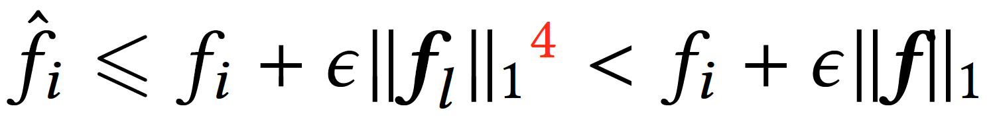
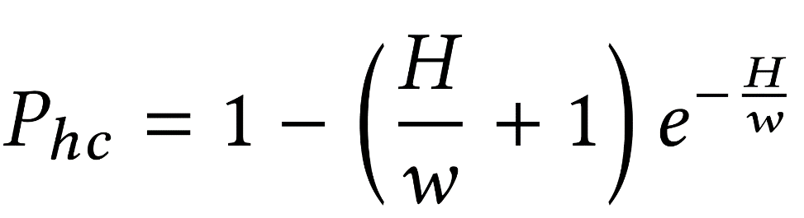
02
Elastic (Basic version)
Error Bound:
Elephant collision: 1+ elephant flows are mapped to the same bucket. Elephant collision rate
f_{A}
f_{B}
f_{C}
Notes:
The packet rate is naturally variable and could vary drastically.
The processing speed of existing sketches on software platforms is fixed in terms of packet rate.

Slide 20
02
Elastic (Adaptivity)
1) Adaptive to Available Bandwidth
2) Adaptive to Packet Rate
3) Adaptive to Flow Size Distribution
Notes:
The packet rate is naturally variable and could vary drastically.
The processing speed of existing sketches on software platforms is fixed in terms of packet rate.

Slide 21
02
Elastic (Adaptive to Bandwidth)
To adapt to available bandwidth
1) the light part is large
2) compress the light part before sending
3 key operations to compress the sketch
1) how to group counters?
2) how to merge counters in a group?
3) how to change hash functions?
Notes:
The packet rate is naturally variable and could vary drastically.
The processing speed of existing sketches on software platforms is fixed in terms of packet rate.

Slide 22
02
Elastic (Adaptive to Bandwidth)
1) split the sketch A into 3 divisions
2) build a sketch B
3) counters with the same index as one group
10%6%3=10%3
10%8%4=10%4
A₁¹[1]
A₁²[1]
A₁²[3]
A₁^{Z}[1]
A₁^{Z}[3]
B₁[1]
B₁[2]
B₁[3]
A1
9
8
87
3
4
88
12
2
9
12
8
88
h(.)%9 →
h(.)%9%3
=h(.)%3
A2
31
12
3
77
0
6
5
10
0
77
12
6
…
…
…
A_{d}¹[1]
A_{d}²[1]
A_{d}^{Z}[1]
B_{d}[1]
Ad
51
14
11
9
10
0
99
1
15
99
14
15
max
Notes:
Here we use an example to show the compression algorithm.
We have a sketch with width of 9, and suppose we want to compress its width to 3.
There are three steps:
first, we split the sketch A into three divisions equally
We build a sketch B with width of 3.
We consider the counters with the same index as one group.
For counters in one group, we have two method to compress them: using the sum value or the max value.
If we use the max, the accuracy can be improved a lot.
Then we show how the hash functions change?
We give two simple example:
And therefore, the hash function is changed from h()%9 to h()%3, therefore, our compression does not need any additional data strucutres.
What’s more, we do not need decompression.

Slide 23
02
Elastic (Adaptive to Bandwidth)
Merging sketches
1) sum merging
2) max merging
Notes:
Then, we can also merge sketches.
Here we show how to merge two sketches with the same hash functions and same size.
Similarly, the counters with the same index are regarded as one group.
For counters in one group, we compress them into one.
Similarly again, we can use the sum value or the max value.
And using max value can achieve much higher accuracy.

Slide 24
02
Elastic (Adaptive to packet rate)
Second, we show how to adapt to high packet rate?
1) buffer the incoming packets in an input queue
2) when # packets in the input queue > Threshold
(1) access only the heavy part
(2) the insertion operation is modified:
if f1 is replaced by f2, then sizeof(f2)= sizeof(f1).

Slide 25
02
Elastic (Adaptive to flow size distribution)
Third, #elephant flows is unknown and can vary a lot
1) # elephant flows in the heavy part is increasing
2) heavy part should be adaptive to changes in
traffic distribution
Solution: copy the heavy part when #elephant flows exceeds a threshold

Slide 26
02
Elastic (Adaptive to flow size distribution)
f2
h(.)%4 → h(.)%8
h(f3)%4=2
h(f3)%8=6
h(f2)%8
Copy part
<f1,…>
<f3,…>
<f6,…>
<f1,…>
<f3,…>
<f6,…>
<f2,…>
Notes:
For example, as shown in this figure, we just copy the heavy part.
After the copy operation, each flow has a redundant copy.
A straightforward solution is to eliminate the redundancy by scanning all buckets.
We propose a lazy elimination.
For example, a flow f2 is mapped to this bucket, we check whether f3 is a redundancy.
After computing the hash function, we find it is a redundancy, and we delete f3 and insert flow f2.
Similar, the hash function is changed from h(.)%4 to h(.)%8.

Slide 27
03
PART THREE
Optimizations
Notes:
Next, we present the third part -- Optimizations

Slide 28
03
Optimizations
To minimize the elephant collision rate,
1) Software Version
2) Hardware Version
3) P4Switch Version
4) Multi-Core Version
Notes:
There are four optimized version:

Slide 29
03
Optimizations (Software Version)
1) use one bucket to store multiple flows
2) all the flows in each bucket share one vote⁻ field
3) try to evict the smallest flow in the mapped bucket
4) use one array in the light part
n-votes
40
<f11,5,T>
<f51,5,T>
0
. . .
. . .
. . .
. . .
4
0
+1
Light part
Heavy part
f8
<f3,72,F>
<f6,11,F>
<f5,55,F>
10+1
f8
7
. . .
. . .
. . .
. . .
1
+7
f9
<f2,16,F>
<f1,74,F>
<f4,7,F>
55+1
f4
2
<f9,1,T>
0
12
Notes:
First, we introduce the software version.

Slide 30
03
Optimizations (Hardware Version)
1) using several sub-tables in the heavy part
2) each flow have several candidate buckets, and thus the elephant collision rate drops significantly.
3) the sub-tables have the same operation but different hash functions, thus suitable for hardware.
Notes:
The packet rate is naturally variable and could vary drastically.
The processing speed of existing sketches on software platforms is fixed in terms of packet rate.

Slide 31
03
Optimizations (P4Switch Version)
1) each stage in two physical stages: vote^{all} , and (key, vote+)
2) When vote^{all} /vote+⩾ λ′, we perform an eviction operation. We recommend λ′ = 32.
3) When an item in a bucket is evicted to the next stage, we consider its frequency as 1.
4) When ( f , vote+) is evicted by ( f1, 1 ), we set the bucket to ( f1, vote+ + 1 ).
vote^{all}
ID
vote+
Notes:
The packet rate is naturally variable and could vary drastically.
The processing speed of existing sketches on software platforms is fixed in terms of packet rate.

Slide 32
03
Optimizations (Multi-Core Version)
10
2
15
thread 1
92
max
4
10
h(.)%2
f4
h(.)%2*3 +h(.)%3
7
15
thread 2
1
92
7
6
4
0
6
Notes:
For each CPU core, we use one thread.
For each thread, we build one sketch.
When all sketches are built completely, we merge them to one.
Similarly, for counters with the same index, we use the max value to achieve high accuracy.

Slide 33
04
PART FOUR
Applications
Notes:
Next, we present out solution – Cold filter

Slide 34
04
Applications
1) Flow size estimation
2) Heavy Hitter detection
3) Heavy Change detection
4) Flow Size Distribution
5) Entropy
6) Cardinality

Slide 35
05
PART Five
Implementations
Notes:
Next, we present the implementations

Slide 36
05
Applications
1) P4Switch
2) FPGA
3) GPU
4) CPU
5) multi-core
6) OVS

Slide 37
06
PART SIX
Experimental results
Notes:
Next, we present experimental results

Slide 38
06
Experiments (Setup)
Traces: CAIDA
Metrics:
ARE, AAE, WMRE, RE, F1Score, Throughput
Trace Date #packets #flows (SrcIP)
CAIDA1 2015/02/19 1164.9M 2.6M
CAIDA2 2015/05/21 1081.0M 3.9M
CAIDA3 2016/01/21 1835.1M 8.9M
CAIDA4 2016/02/18 1799.7M 8.4M
Notes:
This is the experimental setup.
We use four one-hour public traffic traces collected in Equinix-Chicago monitor from CAIDA.

Slide 39
06
Experiments (Setup)
Comparisons:
1) Flow size: CM, CU, Count
2) Heavy Hitter: UnivMon, SS, CM/C+heap, Hash pipe
3) Heavy Change: UnivMon, Reversible sketch, FlowRadar
4) Distribution: MRAC
5) Entropy: UnivMon, Sieving
6) Cardinality: UnivMon, linear counting (LC)
Notes:
This is the algorithms compared in our experiments.

Slide 40
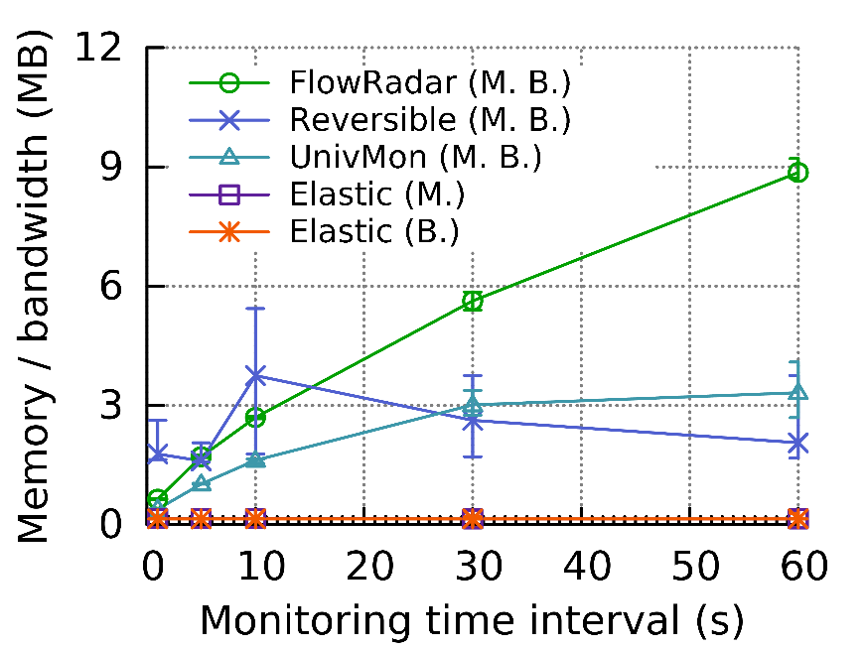
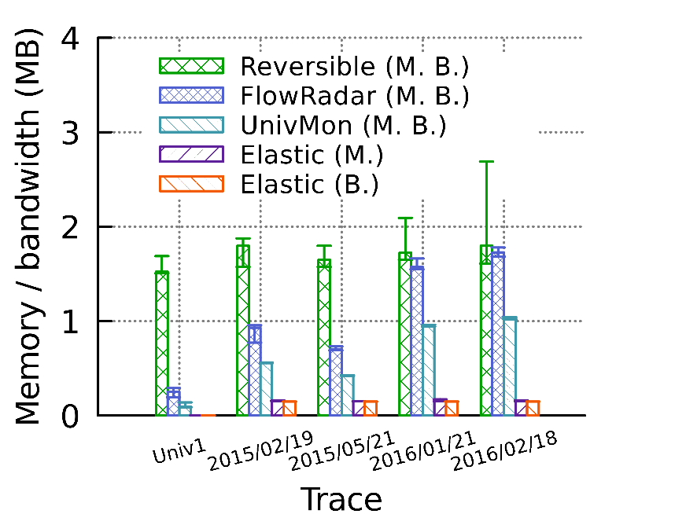
06
Experiments (Memory/Bandwidth)
Memory or bandwidth needed to achieve 99%
precision and recall in heavy change detection
Notes:
For experimental results, the memory , we find that

Slide 41
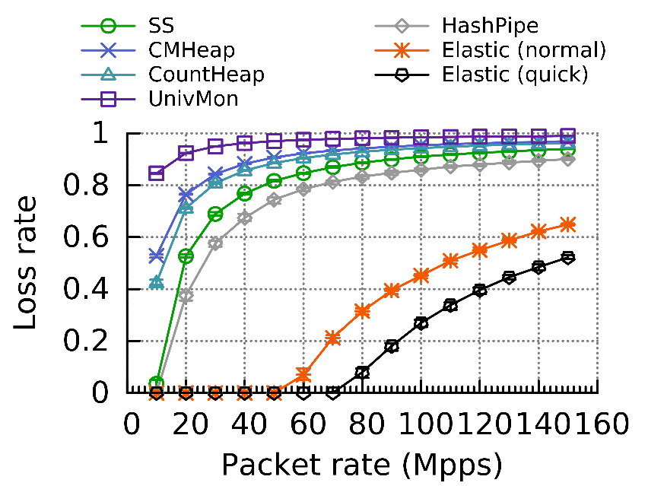
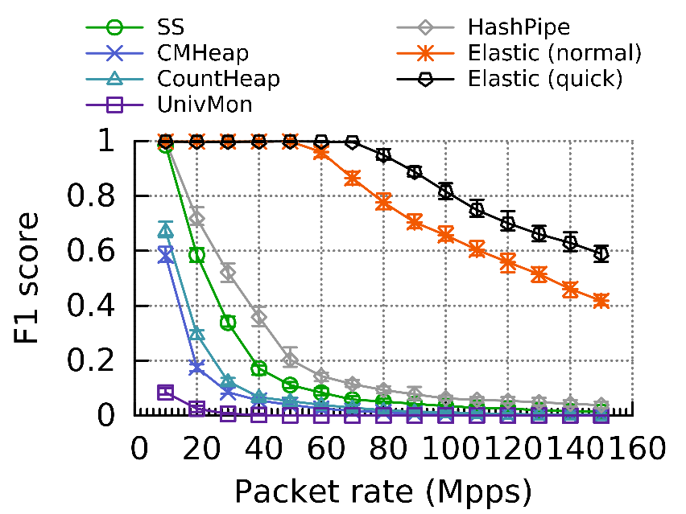
06
Experiments (Adaptivity)
Adaptivity to packet rate
Notes:
We use four one-hour public traffic traces collected in Equinix-Chicago monitor from CAIDA.

Slide 42
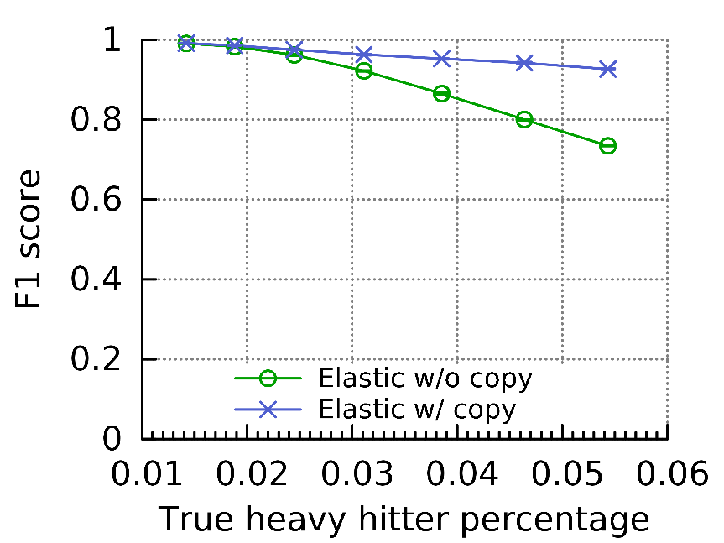
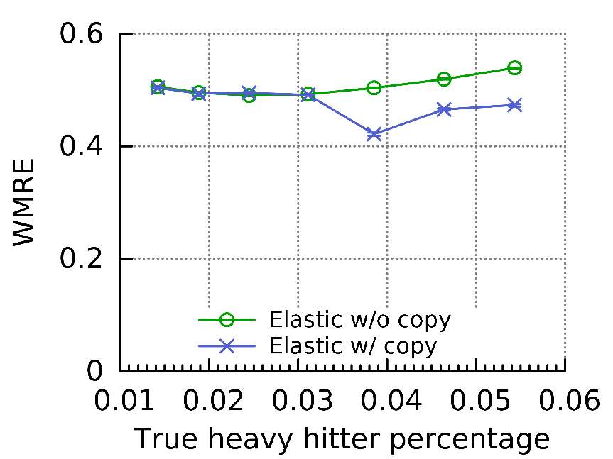
06
Experiments (Setup)
Adaptivity to flow size distribution
Notes:
We use four one-hour public traffic traces collected in Equinix-Chicago monitor from CAIDA.

Slide 43
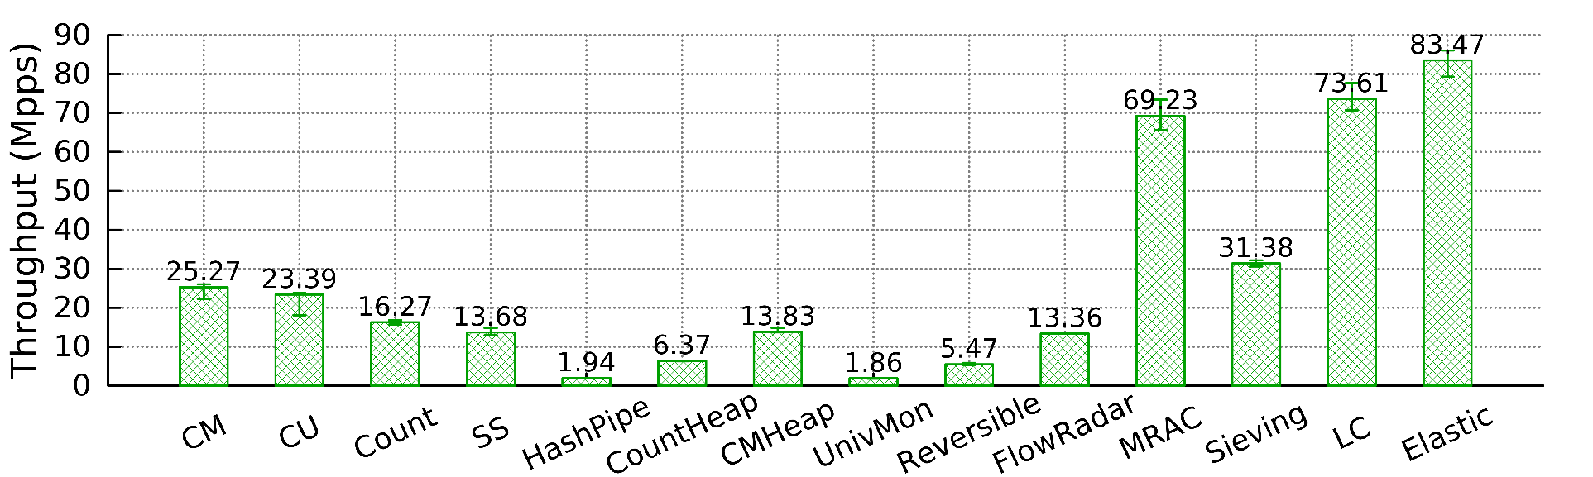
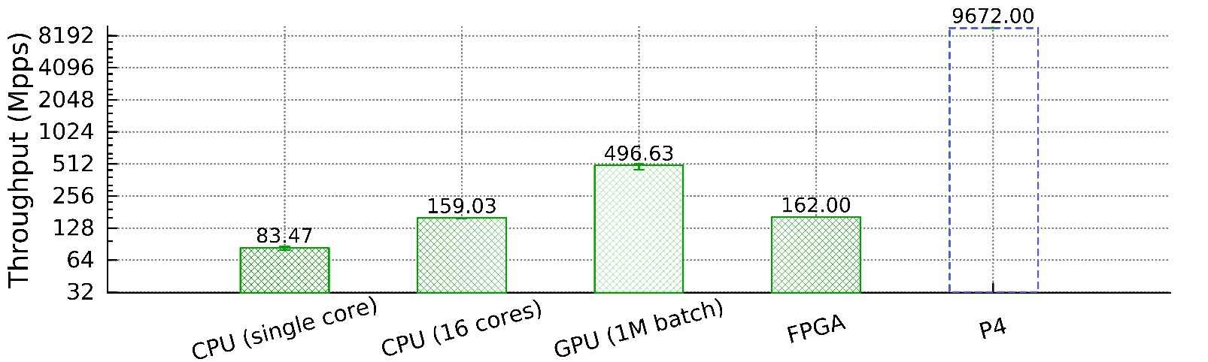
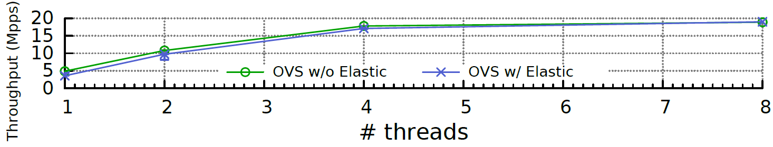
06
Experiments (Processing Speed)
Notes:
We use four one-hour public traffic traces collected in Equinix-Chicago monitor from CAIDA.

Slide 44
06
Experimental Results Summary
Compared to the state-of-the-art,
speed improvement: 44.6 ∼ 45.2 times
accuracy improvement: 2.0 ∼ 273.7 times
Applications for more tasks in the future work.

Slide 45
07
PART SEVEN
Conclusion
Notes:
Next, we present out solution – Cold filter

Slide 46
07
Conclusion
Elastic sketch:
1) elastic, generic, fast, and accurate
2) adaptive to traffic characteristics
3) one sketch for 6 tasks
Key techniques: ostracism and compression
implemented on 6 platforms
P4Switch, FPGA, GPU, CPU, multi-core CPU and OVS
Notes:
We use four one-hour public traffic traces collected in Equinix-Chicago monitor from CAIDA.

Slide 47
THANKS
Source code: https://github.com/ElasticSketch/ElasticSketch
Tong Yang
Peking University, China
Email: yangtongemail@gmail.com
Homepage: http://net.pku.edu.cn/~yangtong/
Notes:
Thanks.

